Slide 1

Predicting NBA Game Outcomes
By: Pete Woo

Slide 2
TABLE OF CONTENTS
About
Our Dataset
Data Cleaning/Analysis
About our project, real world usage
Scope and overview of our dataset
Data cleaning and additional feature implementation
Pred. Models & Results
Key Takeaways
Future Work
Decision Tree, Random Forest, Adaboost and More
Model performance and shortcomings
Future and ethical considerations
Notes:
Ryan

Slide 3
ABOUT THE PROJECT
Develop a predictive analytical model for forecasting NBA game outcomes using machine learning.
Utilize an online dataset with relevant statistics and metrics.
Determine important features
Sports Betting
Magic Number = 67%
Notes:
Ryan

Slide 4
OUR DATASET
Kaggle Dataset (NBA Game Data)
2003 - 2022
Statistics from 26,000 games
Dependent Variable: Win / Loss
Train Data → 2003-2017
Test Data → 2018-2022
Notes:
ryan

Slide 5
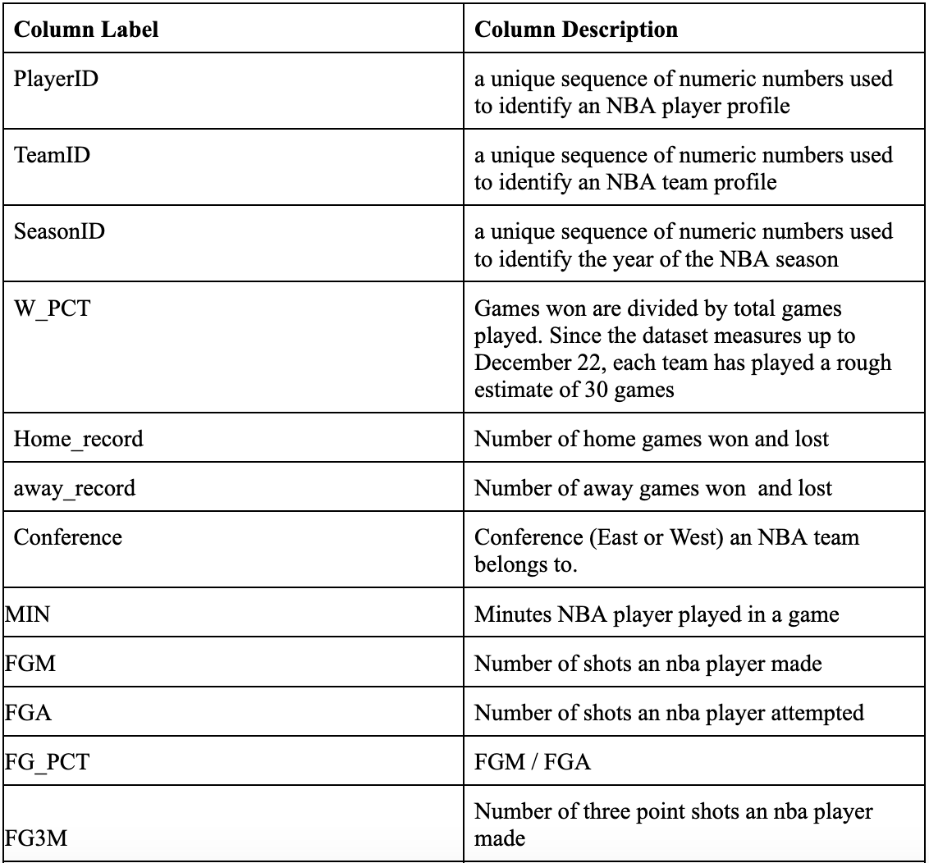
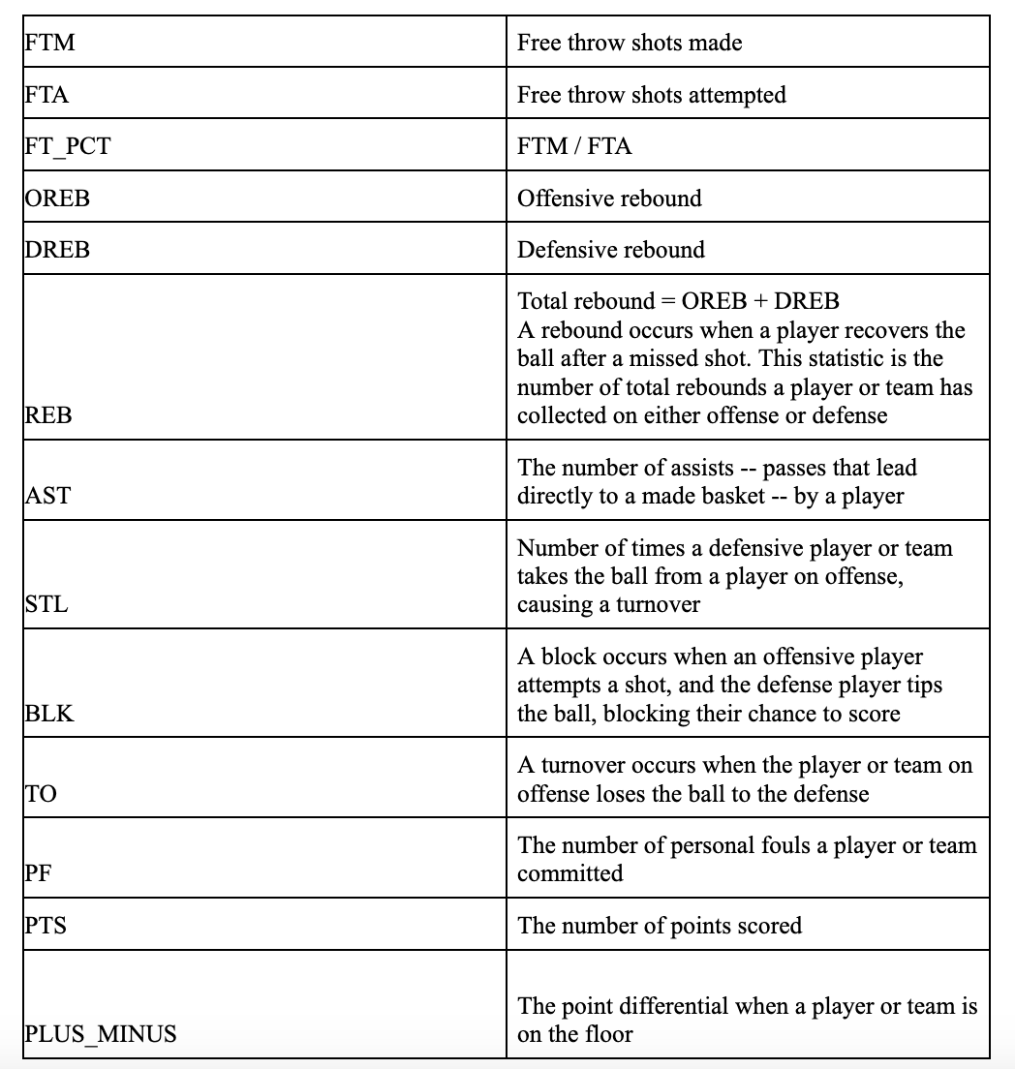
DATA DESCRIPTION
20 columns over 26k rows
Notes:
ryan

Slide 6
DATA CLEANING
Checked for NaN/missing values
Dropped columns:
Game_ID
Game_Status
Duplicate Home & Away Team ID’s
Clean Dataset Overall
Notes:
ryan

Slide 7
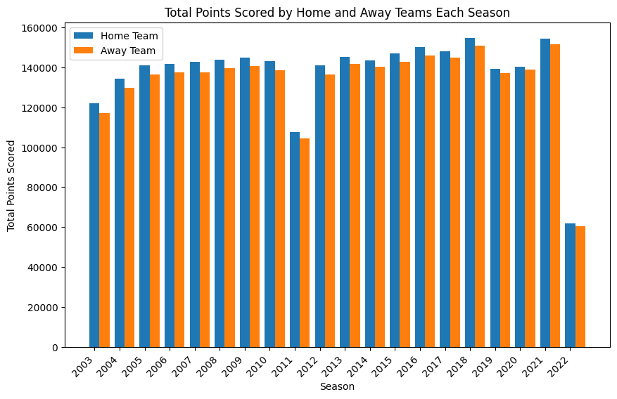
SUMMARY STATISTICS
Home team scores more points
Most points scored in 2021

Slide 8
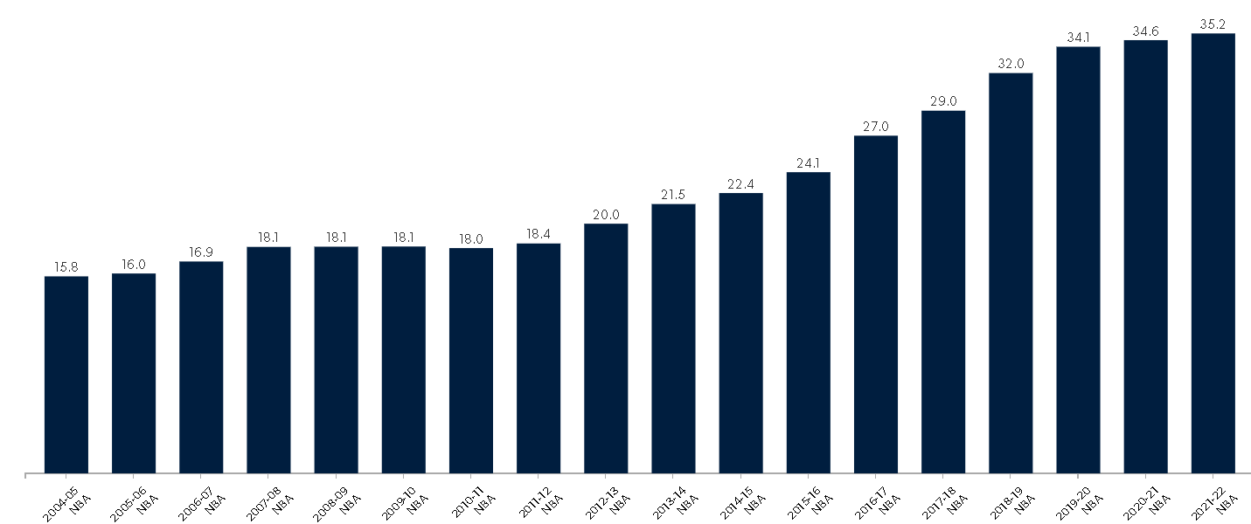
SUMMARY STATISTICS
League average 3pa per game by season since 2005
Notes:
Nathan

Slide 9
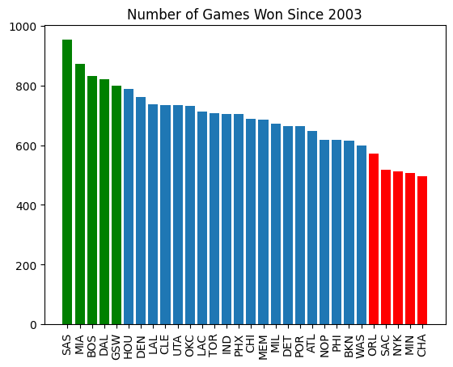
SUMMARY STATISTICS

Slide 10
DATA PREPROCESSING
Duplicating each row
“Target Win” (Output Variable)
Rolling Averages

Slide 11
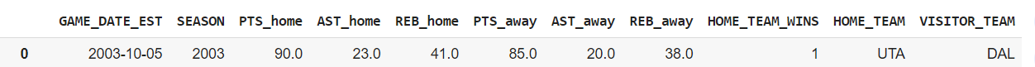
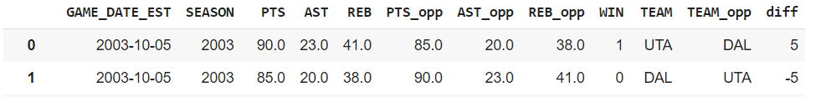
DUPLICATING EACH ROW

Slide 12
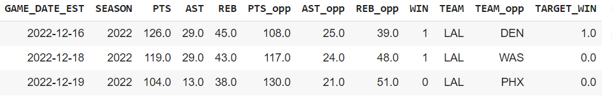
TARGET WIN

Slide 13
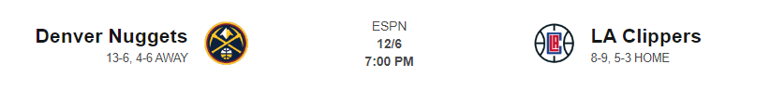
ROLLING AVERAGES
Problem: When predicting outcome of a future game, statistics for that game do not exist.

Slide 14
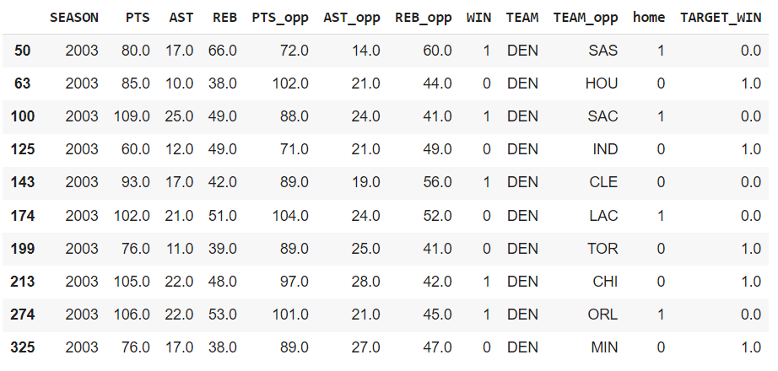
ROLLING AVERAGES
Solution: Train classification model on average statistics of last N games.

Slide 15

ROLLING AVERAGES
Statistics Averaged from Last 10 Games
Later tested prediction accuracy by using rolling averages for last 5, 10, 15, and 20 games.

Slide 16
OUR APPROACH
Classification: A game is either won or loss
1
2
3
4
Decision Tree
Random Forest
AdaBoost
Model ~ N Games
KFold
Feature Elim
Hyperparameter Tuning
KFold
Hyperparameter Tuning
KFold
Hyperparameter Tuning
Find optimal n number of games to take rolling average from

Slide 17
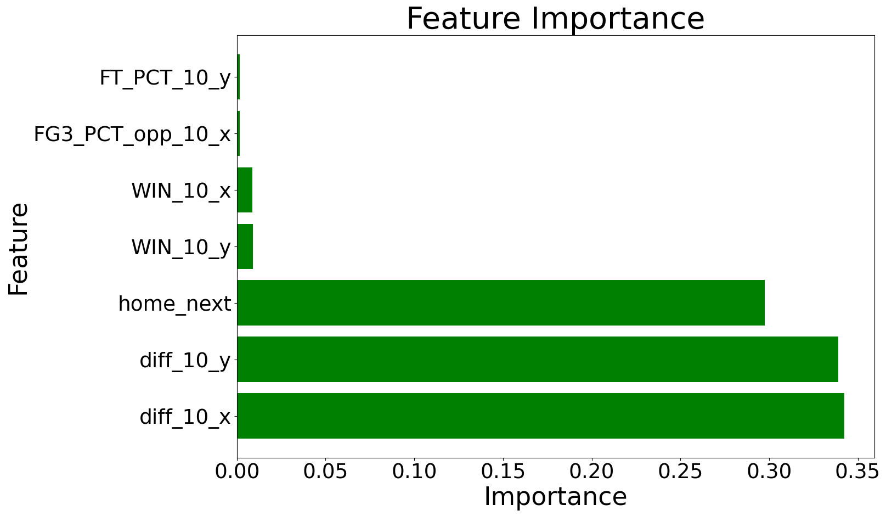
DECISION TREE (N=10)
Hyperparameters:
From randomized grid search obtained
Max Depth: 5
Min Sample Leaf: 112
Min Samples Split: 2
F1 Score:
Train = 0.64
Test = 0.60

Slide 18
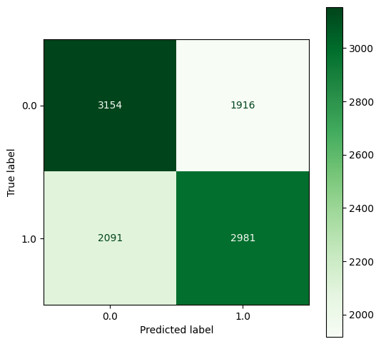
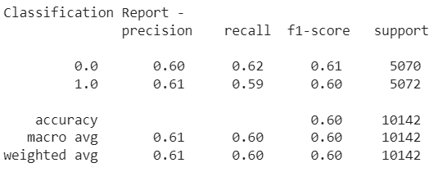
DECISION TREE (N = 10)

Slide 19
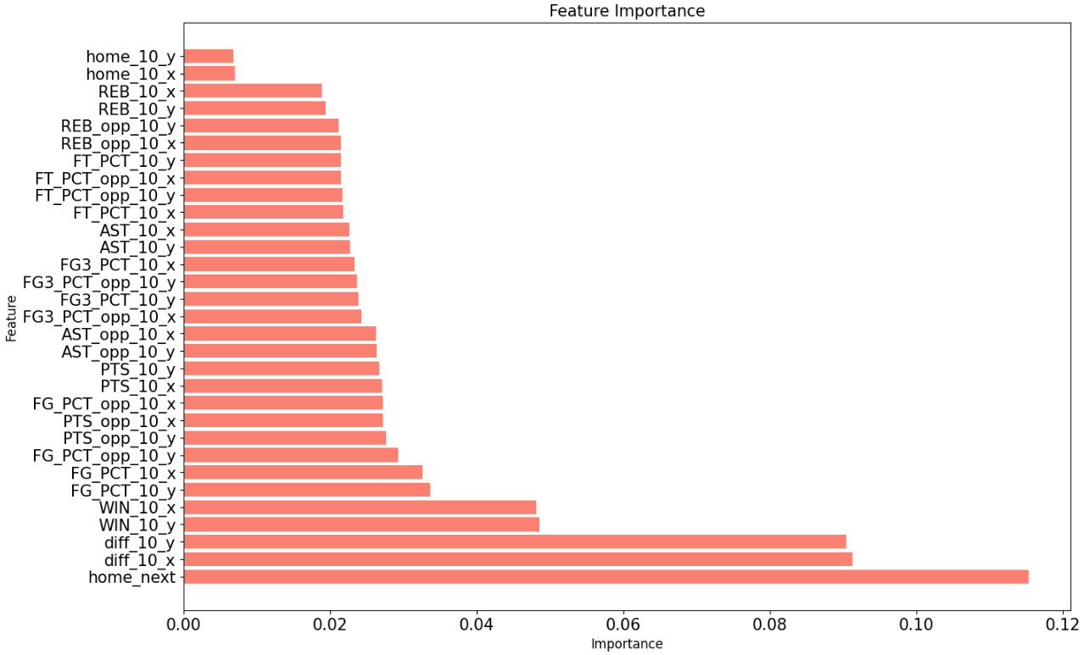
RANDOM FOREST (N = 10)
Hyperparameters:
From randomized grid search obtained
N estimators: 350
Max Depth: 14
Min Sample Leaf: 20
Min Samples Split: 10
F1 Score:
Train = 0.65
Test = 0.62

Slide 20
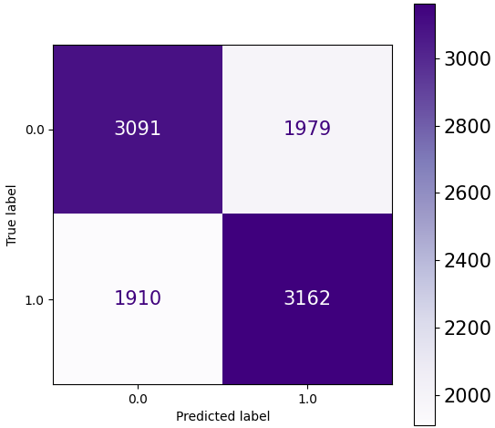
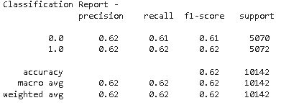
RANDOM FOREST (N = 10)

Slide 21
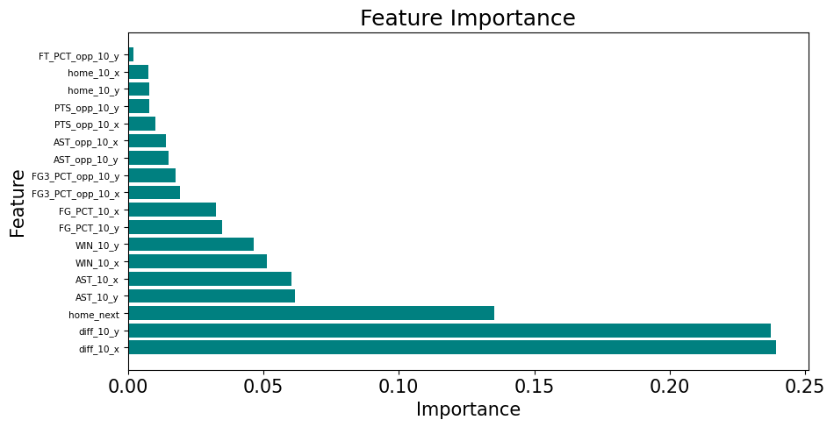
ADABOOST (N=10)
Hyperparameters:
From randomized grid search obtained
N estimators: 500
Learning Rate: 0.25
F1 Score:
Train = 0.65
Test = 0.61
Notes:
ryan

Slide 22
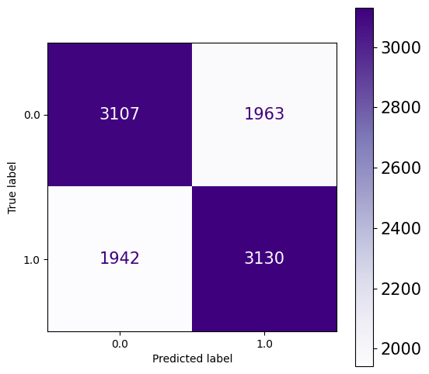
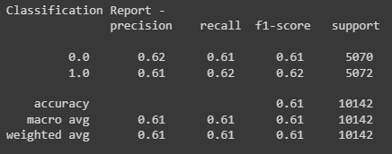
ADABOOST (N=10)
Notes:
Ryan

Slide 23
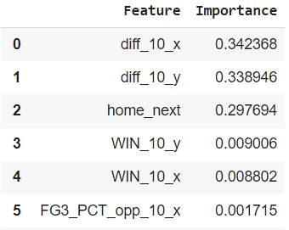
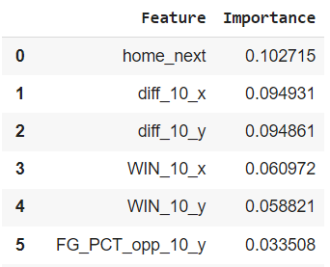
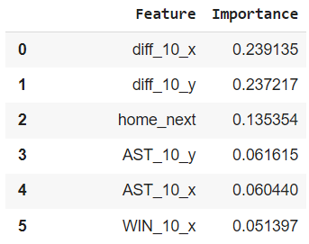
MODEL COMPARISON
Decision Tree
Random Forest
AdaBoost
F1: 0.6
F1: 0.62
F1: 0.61
Notes:
Nathan

Slide 24
RANDOM FOREST ON 5/10/15/20 ROLLING AVERAGES
N estimators: 350
Max Depth: 14
Min Sample Leaf: 20
Min Samples Split: 10
N estimators: 350
Max Depth: 14
Min Sample Leaf: 20
Min Samples Split: 10
5
0.607
10
0.62
15
0.63
20
N estimators: 250
Max Depth: 16
Min Sample Leaf: 20
Min Samples Split: 10
0.64
N estimators: 330
Max Depth: 8
Min Sample Leaf: 20
Min Samples Split: 5
Notes:
Nathan

Slide 25
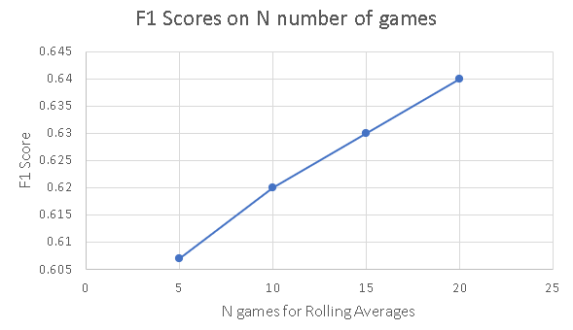
RANDOM FOREST ON LAST 5/10/15/20 GAMES
As N increased, the prediction accuracy (F1) of the Random Forest Model also increased.
Notes:
Nathan

Slide 26
Voting Ensemble

Slide 27
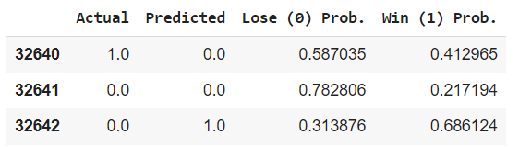
Alternate Improvement Method
Idea: Increase minimum Prediction Probability required to make a Prediction
Therefore, the predictions are more certain and model is more selective.

Slide 28
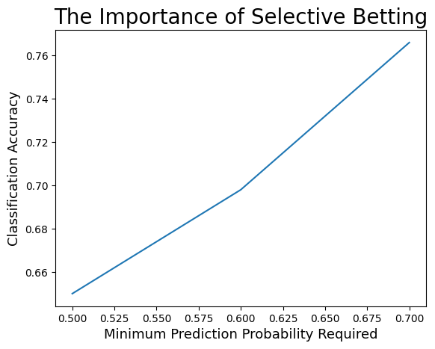

Slide 29
SHORTCOMINGS
1 | 2 | 3
Advanced Stats | Injuries | Model trained on older data

Slide 30

KEY TAKEAWAYS
Ideal Model: Random Forest
Most Important Features:
Point differential of last n games
Whether or not the next game will be played with a home advantage
Data:
All models did moderately well on our dataset, but there is room for improvement as the dataset itself is missing features we think might have significant performance
Higher N games of rolling averages seem to affect model performance, peaking at around 20-25 past games
Models tend to overfit
Notes:
Ryan

Slide 31
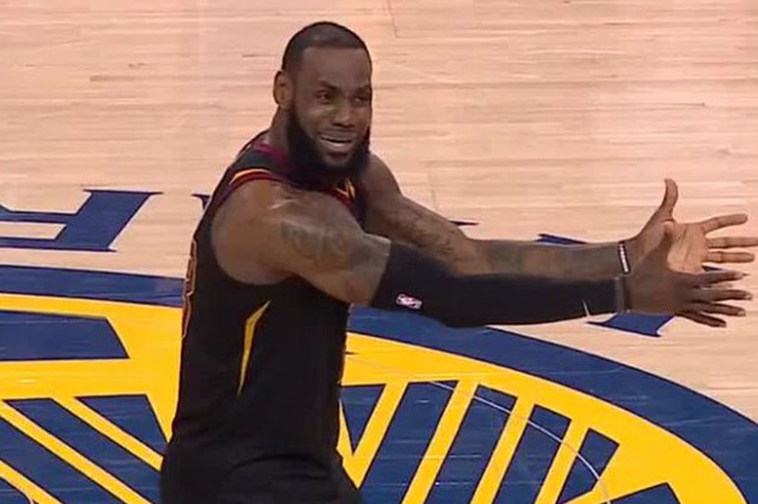
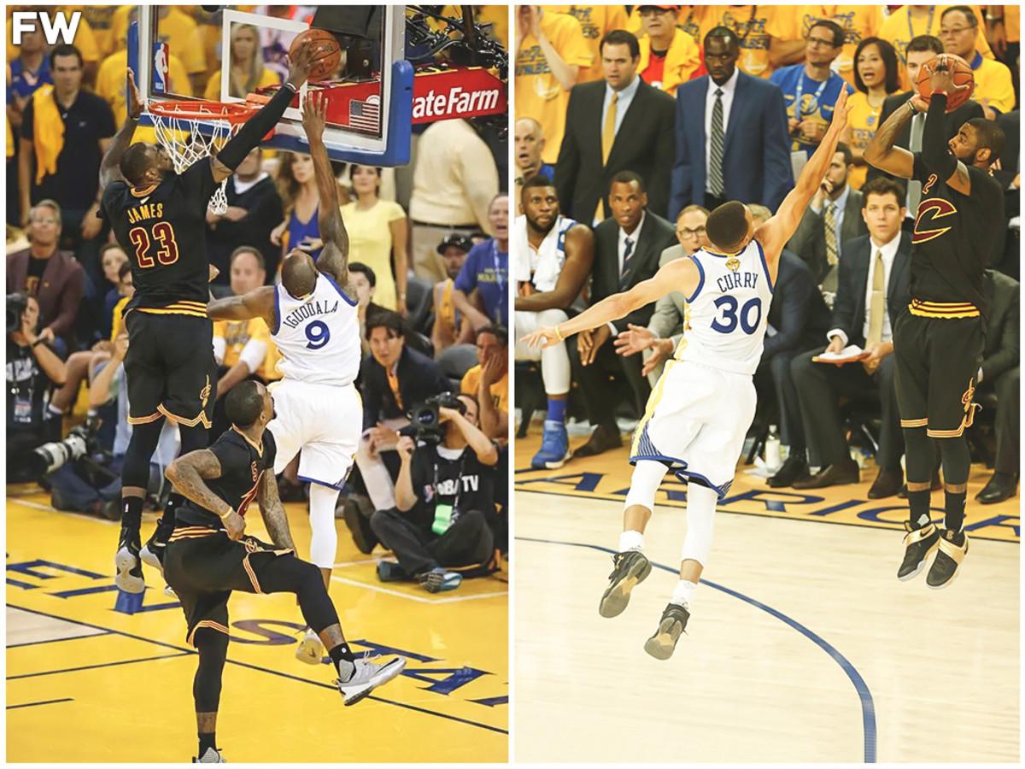
FUTURE WORK & ETHICAL CONSIDERATIONS
Future Work:
NBA players are constantly getting better (there are specific advanced stats that are not accounted for)
The way the game is played changes over time.
Would need to keep updating the model
Ethical Considerations:
Sports are unpredictable and many factors can influence the result of a game.
The model provides insights based on historical data, but does not account for every variable.
Notes:
Ryan

Slide 32
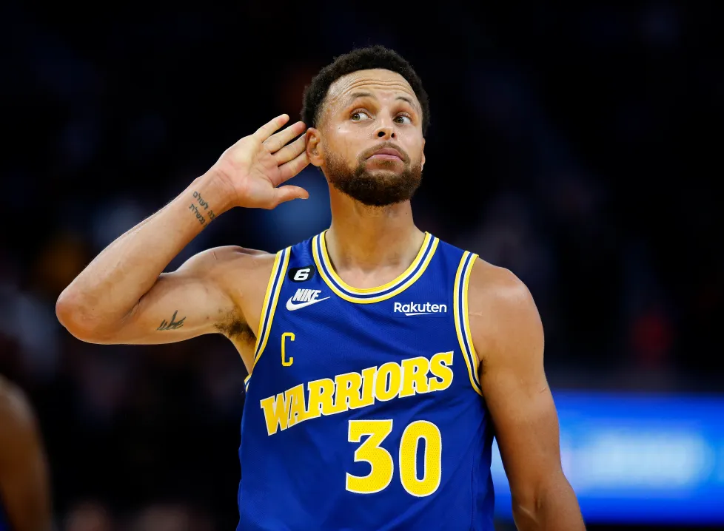
THANK YOU! ANY QUESTIONS?

Slide 33
REFERENCES
[1] https://medium.com/the-intelligent-sports-wagerer/why-52-4-is-the-most-important-percentage-in-sports-gambling-16ade8003c04
[2] https://sitpicks.com/what-percentage-of-sports-bettors-win/
[3] https://thegameday.com/how-to-bet/spread/
[4] J. Lu, Y. Chen and Y. Zhu, "Prediction of Future NBA Games' Point Difference: A Statistical Modeling Approach," 2019 International Conference on Machine Learning, Big Data and Business Intelligence (MLBDBI), Taiyuan, China, 2019, pp. 252-256, doi: 10.1109/MLBDBI48998.2019.00056.
[5] Jones, E. S. (2016). Predicting outcomes of NBA basketball games (Order No. 10150581). Available from ProQuest Dissertations & Theses Global: The Humanities and Social Sciences Collection; ProQuest Dissertations & Theses Global: The Sciences and Engineering Collection. (1815028507).
[6] https://www.kaggle.com/datasets/nathanlauga/nba-games?select=teams.csv

